Slide 1
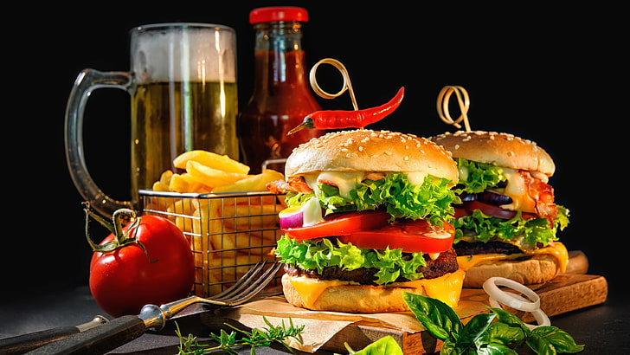

CASE STUDY ON BTM LAYOUT FAST FOOD CENTRE
A DESIGN THINKING APPROACH TO FIND A SOLUTION FOR HIS BUSINESS
By - Jagili Bhanu Prakash Daivajna

Slide 2
BUSINESS PROBLEM: A man took a shop for rent near BTM layout, Bangalore to sell fast food with a rent of Rs.14000 per month. He made a profit of Rs. One lakh in the first three months, after which the sales has gone down drastically and is thinking to close his shop.
AGENDA : To find a solution to run his business back with profits.
Analyse how to improve his profits
Get his sales data and operational expansions of his fast food centre.
Do a deep study of the local market /
competitors

Slide 3
Analysis of BTM food courts weekly sales data
Sales started on a positive note in the first month when the shop was open. Slowly ,the sales started to decrease drastically after the third month. Even the last month two month rent is due to be paid.
KEY PERFORMANCE INDICATORS:
 | Month wise sales and Profit
Row Labels | Sum of Monthly Sales | Sum of Profit (Net sales- expenses)
Jan (Week no-1 to4) | 160900 | 80900
FEB(Week 5 to 8) | 85000 | 10000
MAR (Week 9 to 12) | 54100 | 9100
APR( week 13 to 16) | 23500 | -23500
MAY( week 17 to 20) | 11500 | -35500
Grand Total | 335000 | 41000
Sales made in first three months: Rs.3,00,000 lakh.
Profits in first three month: 1,00,000 lakh.

Slide 4
As the stock was not moving out and sales was not happening as expected, he stopped purchasing meat/NV and making non Vegetarian items. So from third month, his expenses on goods reduced. But profits were not increasing. On the other hand, Sales fell down even badly. He had to face huge losses.
Upon deep analysis and market research,
It is found that the costs of food items are priced very high when compared to other shops in the area. Also certain facilities has to be added to improve the business.

Slide 5




Actions to be taken to improve fast food business.
Increase functioning hours of the shop. Other shops in the locality are open for around five and half to six hours. It is suggested to open an hour before. Evening is the time to attract college students and teens to munch on their fav foods.. Hence the new timings would be 04.30pm to 10.45pm
Customers always prefer quality food and quick service. Necessary action and additional care is taken to maintain the excellent quality in food and quick service.
Make tie-ups with delivery partners like Swiggy, Zomato, UberEats etc.
Expand your online presence through Just dial pages, fb page,etc.

Slide 6

NAME OF THE FOOD- VEG NOODLES EGG BHUJIA PANER SANDWICH VEG ROLL CHICKEN KEBAB
New proposed price : 94 90 85 84 98
(Rs.2 less than the average cost of competitors price)
Discounts offered:
5% off on orders above Rs.200
7% off on orders above Rs.300
To improve the sale of non veg dishes. Plan attractive offers on them like..
Buy 2 Chicken kebabs , Get 1 veg Roll FREE.
Buy 2 egg rolls , get 1 paneer sandwich FREE.
If the sales are found to increase, introduce more varieties in menu and some special items on Weekends.
End of case study
Thankyou and best wishes.

